Slide 1

Constitutional Law, cyber law, ip law and professional ethics
Unit-1: Introduction to Constitution of India.

Slide 2
CONSTITUTIONAL LAW-I
Art. 13
13. Laws inconsistent with or in derogation of the fundamental rights
  (1) All laws in force in the territory of India immediately before the commencement of this Constitution, in so far as they are inconsistent with the provisions of this Part, shall, to the extent of such inconsistency, be void
  Laws
  In force
  In the territory
  before the commencement of this Constitution.
  Inconsistent with part III
  Extent of inconsistency
  Void

Slide 3
CONSTITUTIONAL LAW-I
Art. 13
13. Laws inconsistent with or in derogation of the fundamental rights
  (2) The State shall not make any law which takes away or abridges the rights conferred by this Part and any law made in contravention of this clause shall, to the extent of the contravention, be void

Slide 4
CONSTITUTIONAL LAW-I
Art. 13
  (3) In this article, unless the context otherwise requires
    (a) law includes any Ordinance, order, bye law, rule, regulation, notification, custom or usages having in the territory of India the force of law;
    (b) laws in force includes laws passed or made by Legislature or other competent authority in the territory of India before the commencement of this Constitution and not previously repealed, notwithstanding that any such law or any part thereof may not be then in operation either at all or in particular areas
  (4) Nothing in this article shall apply to any amendment of this Constitution made under Article 368.

Slide 5
CONSTITUTIONAL LAW-I
Art. 13
Article 13(1) : pre-Constitutional law
Article 13(2): post-Constitutional Law
Article 13(3): defines laws in force and law in 13(1) and 13(2)
Article 13(4): exclusion of Constitutional Amendments from preview of Article 13

Slide 6
CONSTITUTIONAL LAW-I
Unconstitutionality of Statutes
Article 13(1) & Article 13(2)
  Deals with legislation inconsistent with provisions of Part III of the Constitution.
  Void and Void ab initio
    Article 13(1): pre-constitutional law are void from 26/01/1950
    Article 13(2): post-constitutional law are void from inception or void-ab-initio

Slide 7
CONSTITUTIONAL LAW-I
Unconstitutionality of Statutes
Three Doctrine pertaining to Article 13
  Doctrine of Eclipse
  Doctrine of Severability
  Waiver of Fundamental Rights

Slide 8
CONSTITUTIONAL LAW-I
Doctrine of Eclipse
Doctrine of Eclipse
  pre-constitutional inconsistent with fundamental rights was not wiped out altogether from the statute book after the commencement of the Constitution
  continued to exist in respect of rights and liabilities which had accrued before the date of commencement of Constitution
  the law in question will be regarded as having been eclipsed for the time being by the relevant fundamental right
  will be in a dormant state for the time being

Slide 9
CONSTITUTIONAL LAW-I
Doctrine of Severability
A law is void only to the extent of the inconsistency or contravention with relevant fundamental rights. Art 13(1) means that an Act may not be void as a whole, only a part of it may be void and if that part is severable from the rest which is valid, then the rest may continue to stand and remain operative. If it is not possible to separate the valid from the invalid portion, then the whole statute will have to go. The rule the invalidity is only to the extent of inconsistency is not peculiar to the Constitution rather is a general principle of statutory interpretation. In determining whether the valid parts of a statute are severable from the invalid, the intention of the legislature is the determining factor.

Slide 10
CONSTITUTIONAL LAW-I
Waiver of Fundamental Rights
No person can waive of his or her fundamental rights that are guaranteed on him or her by the State, not even with his or her own will.

Slide 11
CONSTITUTIONAL LAW-I
Waiver of Fundamental Rights
Art. 13(3)b
Statutory laws
Order – made in pursuance of statutory authority
bye law – local authorities
Rule- delegated legislation
Regulation- regulate day to day
Notification- announcement
custom or Usages
Having force of law

Slide 12
CONSTITUTIONAL LAW-I
Waiver of Fundamental Rights
13(4) Nothing in this article shall apply to any amendment of this Constitution made under Article 368.
Shankari Prasad V. Union of India
  An amendment is not a law within the meaning of Article 13(2)
Sajjan singh V. State of Rajasthan
  Followed the previous decision
I.C Golaknath V. State of Punjab
  Overruled its decision in Shankari Prasad and Sajjan Singh
  24th Amendment Act, 1971
Kesavananda Bharti V. State Of Kerela
  Basic Structure

Slide 13
CONSTITUTIONAL LAW-I
Doctrine of Equality: Article 14
Right to Equality
  Article 14 to 18
  One of the essential aspect of Indian Constitution
  Specific mention in the Preamble

Slide 14
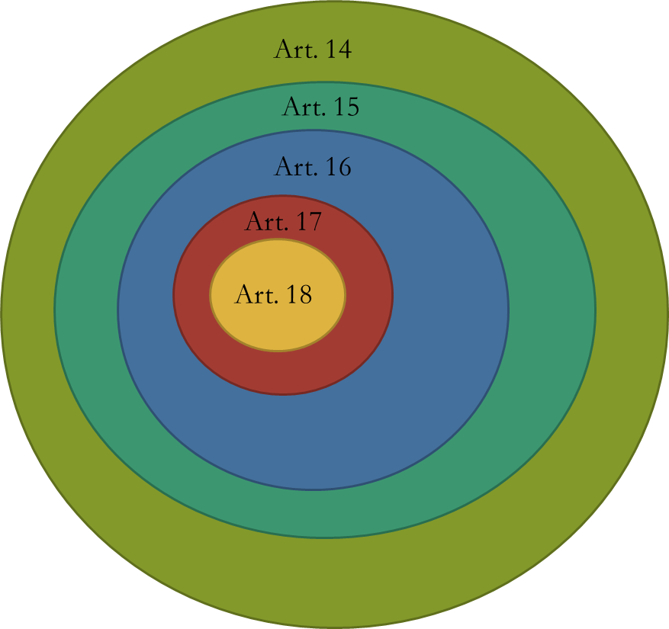
CONSTITUTIONAL LAW-I
Doctrine of Equality: Article 14

Slide 15
CONSTITUTIONAL LAW-I
Doctrine of Equality: Article 14
Right to Equality
  Article 14
Equality before law
The State shall not deny to any person equality before the law or the equal protection of the laws within the territory of India
Any person

Slide 16
CONSTITUTIONAL LAW-I
Doctrine of Equality: Article 14
Article 14 embodies two principles
  Equality before law
    British Concept
    Negative concept – not to be discriminated- forbids
    Rule of Law
  Equal Protection of Law
    US Concept
    Positive concept – Provide something
    Not absolute equality
    Equals to be treated equally and unequals should not be treated equally

Slide 17
CONSTITUTIONAL LAW-I
Doctrine of Equality: Article 14
Equal Protection of Laws
  Article 14 forbids class legislation, it does not forbids reasonable classification for the purpose of legislation.
  Reasonable Classification

Slide 18
CONSTITUTIONAL LAW-I
Doctrine of Equality: Article 14
Test for Reasonable Classification
Intelligible Differentia
  Shall not be arbitrary, artificial or evasive
  Real and substantial distinction
Reasonable Nexus between Intelligible Differentia and objective sought to be achieved by the Act.
  Eg: Sec 11 of Indian Contract Act
Object should be lawful

Slide 19
CONSTITUTIONAL LAW-I
Article 15-16 and the finer dimensions of equality
Article 15 & 16 provides for finer dimension of equality
Article 15 prohibits discrimination
Article 16 prohibits discrimination in public employment
Article 15 and 16 applicable only to citizens

Slide 20
CONSTITUTIONAL LAW-I
Article 15-16 and the finer dimensions of equality
Art. 15(1) The State shall not discriminate against any citizen on grounds only of religion, race, caste, sex, place of birth or any of them.

Slide 21
CONSTITUTIONAL LAW-I
Article 15-16 and the finer dimensions of equality
Art. 15 (2) No citizen shall, on grounds only of religion, race, caste, sex, place of birth or any of them, be subject to any disability, liability, restriction or condition with regard to—
  access to shops, public restaurants, hotels and places of public entertainment; or
  the use of wells, tanks, bathing ghats, roads and places of public resort maintained wholly or partly out of State funds or dedicated to the use of the general public.

Slide 22
CONSTITUTIONAL LAW-I
Article 15-16 and the finer dimensions of equality
Art. 15 (3)
Nothing in this article shall prevent the State from making any special provision for women and children.
    Reservation of jobs for women in state employment is permissible even in the absence of special provision under Art. 16

Slide 23
CONSTITUTIONAL LAW-I
Article 15-16 and the finer dimensions of equality
Art. 16
There shall be equality of opportunity for all citizens in matters relating to employment or appointment to any office under the State.
Equality of opportunity- right to be considered for employment or appointment
No right to be employed or appointed
  Selection test?
  Rules of selection test
Citizens

Slide 24
CONSTITUTIONAL LAW-I
Article 15-16 and the finer dimensions of equality
Matters relating to Employment or appointment
Employment
  Prior and subsequent
Appointment
  Termination, removal
Under the State.

Slide 25
CONSTITUTIONAL LAW-I
Article 15-16 and the finer dimensions of equality
Art. 16
No citizen shall, on grounds only of religion, race, caste, sex, descent, place of birth, residence or any of them, be ineligible for, or discriminated against in respect of, any employment or office under the State.
  16 (1) is wider
  No restriction on private persons
Gazula Dasaratha Rama Rao V. State of A P
  Madras Hereditary Village Officers Act, 1895
Compassionate Appointments?

Slide 26
CONSTITUTIONAL LAW-I
Article 15-16 and the finer dimensions of equality
Art. 16
Nothing in this article shall prevent Parliament from making any law prescribing, in regard to a class or classes of employment or appointment to an office under the Government of, or any local or other authority within, a State or Union territory, any requirement as to residence within that State or Union territory prior to such employment or appointment.

Slide 27
CONSTITUTIONAL LAW-I
Article 15-16 and the finer dimensions of equality
Article 15 and 16 together provides for reservation and special provisions for backward class, SC and ST communities.
Nothing in this article or in clause ( 2 ) of Article 29 shall prevent the State from making any special provision for the advancement of any socially and educationally backward classes of citizens or for the Scheduled Castes and the Scheduled Tribes

Slide 28
CONSTITUTIONAL LAW-I
Article 15-16 and the finer dimensions of equality
Art. 15 (5)- Nothing in this article or in sub-clause (g) of clause (1) of article 19 shall prevent the State from making any special provision, by law, for the advancement of any socially and educationally backward classes of citizens or for the Scheduled Castes or the Scheduled Tribes in so far as such special provisions relate to their admission to educational institutions including private educational institutions, whether aided or unaided by the State, other than the minority educational institutions referred to in clause (1) of article 30.

Slide 29
CONSTITUTIONAL LAW-I
Art. 17 & 18
Article 17 : Abolition of Untouchability: Untouchability is abolished and its practice is forbidden in any form. It is an offence which is punishable in accordance with law. Protection of Civil Rights, 1955 has been implemented in India.
Article 18: Abolition of Titles (Rajabahudur, Diwan etc)

